Slide 1
4d Visualisation of the tropopause, identification of air mass exchanges and their fate
Motivation and work plan draft
Martin Frank (SCC) and Roland Ruhnke (IMK)

Slide 2
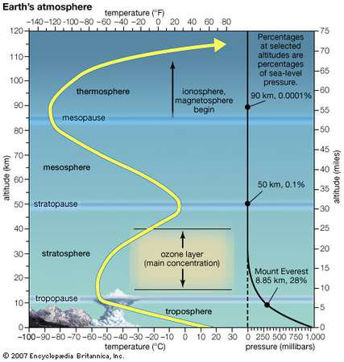
Figure 1. The tropopause is the interface between the troposphere and the stratosphere. The tropopause is located at about 10 km altitude and associated with a local minimum in temperature.
The tropopause is the key region for radiative forcing of greenhouse gases and hence for the greenhouse gases induced climate change.
The tropopause is a highly dynamical interface in space and time.

Slide 3

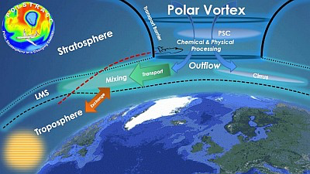
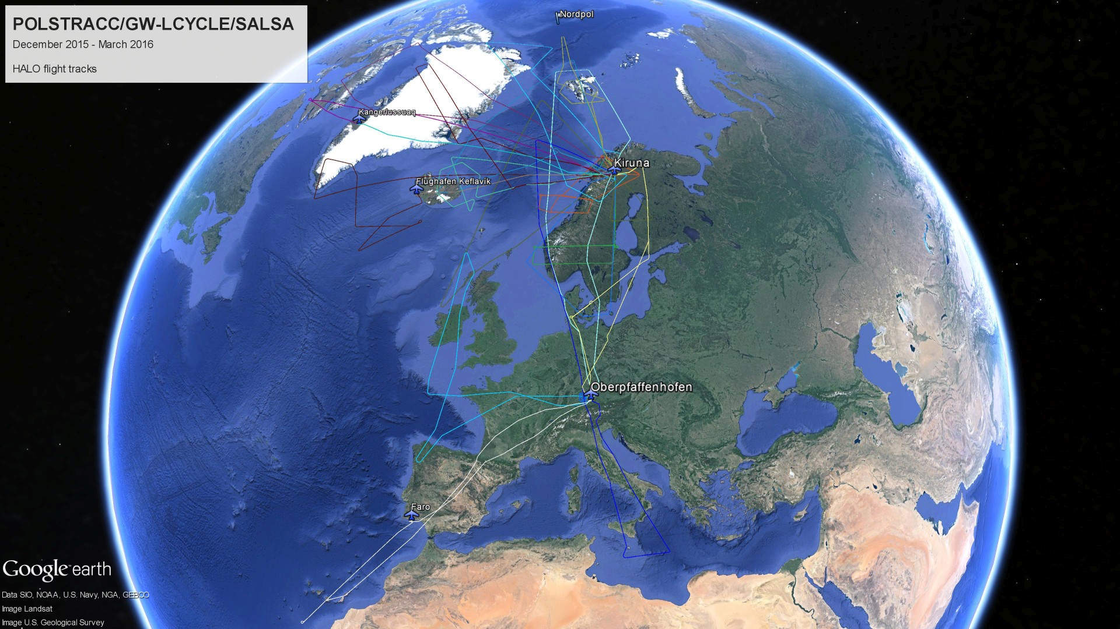
Figure 2. The processes at the polar tropopause region have been investigated in a couple of research flights with the german HALO aircraft with the POLSTRACC campaign (http://www.halo.dlr.de/science/missions/polstracc/polstracc.html)

Slide 4
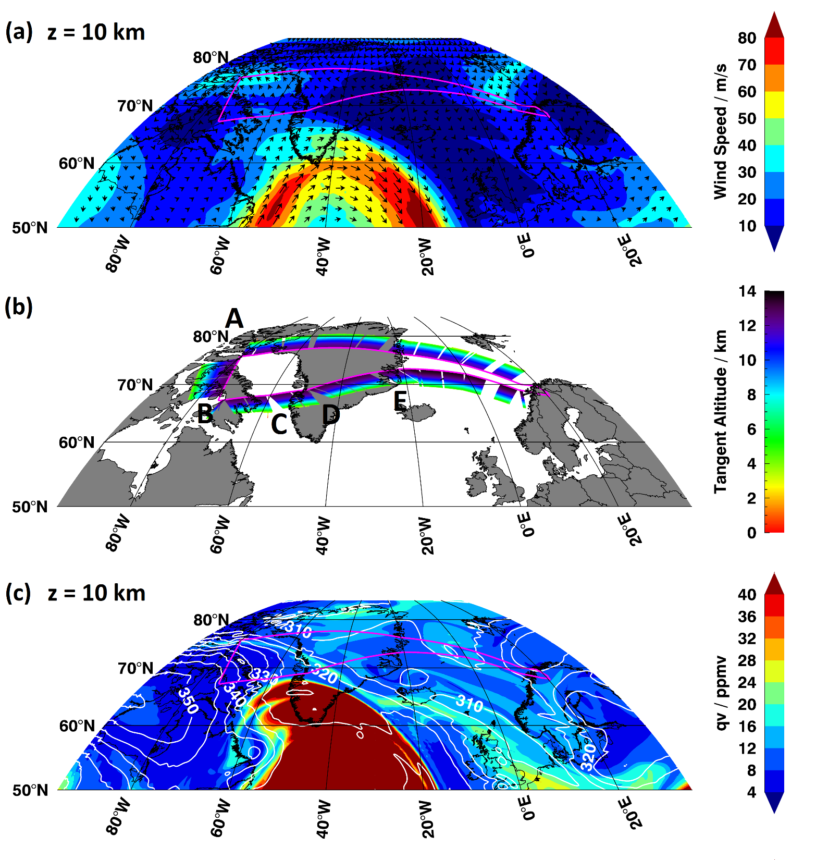
Figure 3. Meteorological situation and GLORIA sampling during HALO flight #14 on 26 February 2016.
HALO flight track indicated by magenta line in all panels.
ICON-ART simulated horizontal wind speed (colour-coded contour and arrows) at 10 km altitude.
GLORIA measurement tangent points, colour-coded with altitude.
ICON-ART simulated specific humidity qv (colour-coded contour) and potential temperature (white contour lines) at 10 km altitude.
The area within the strong horizontal wind gradient is associated with high values of specific humidity indicating tropospheric air at 10 km altitude.

Slide 5
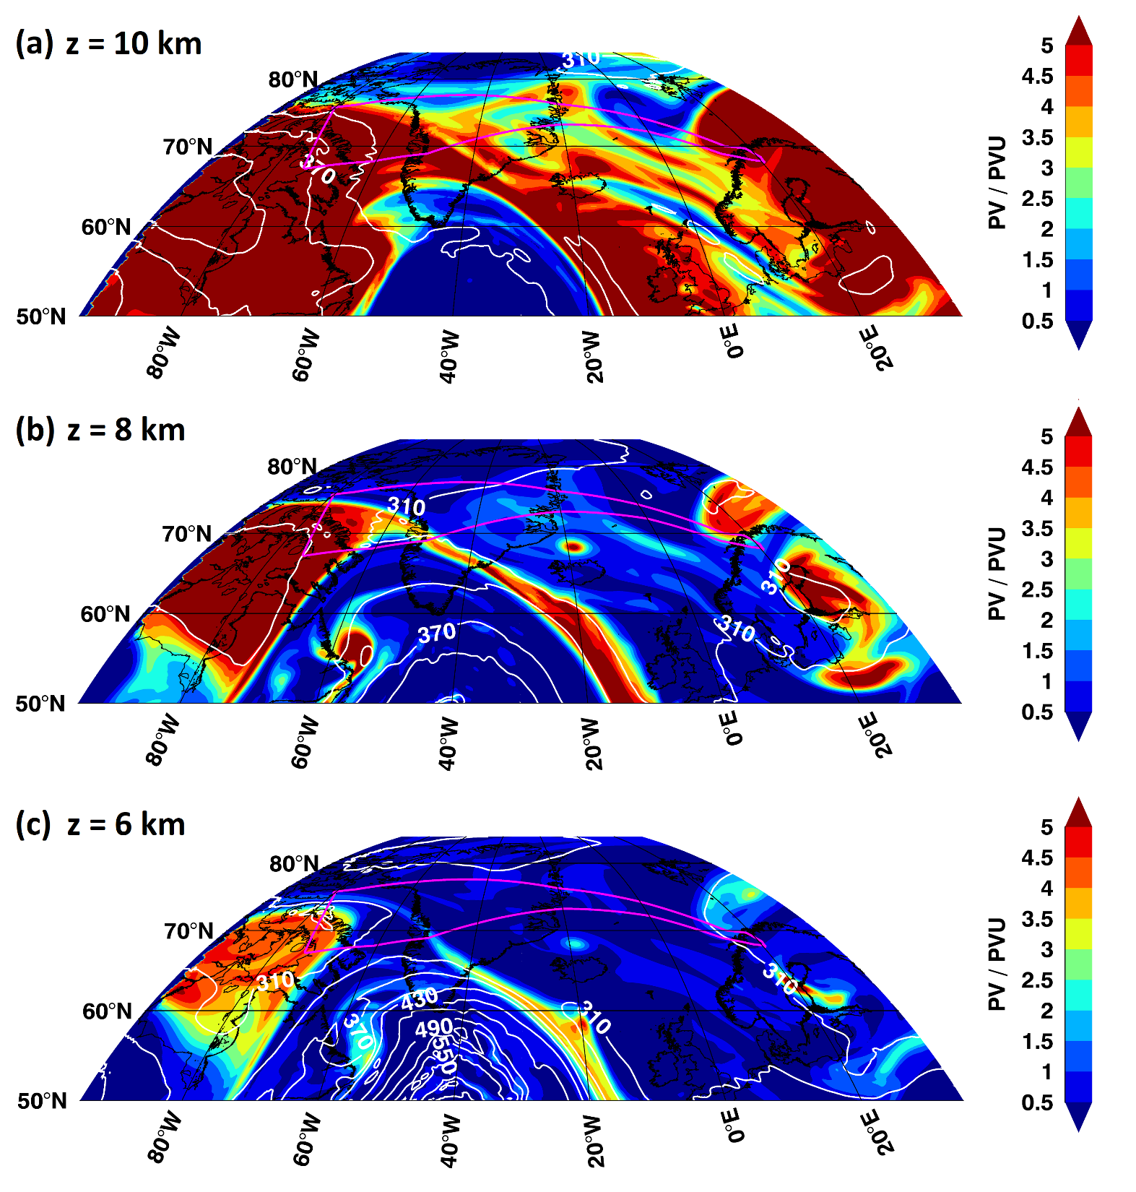
Figure 4. ICON-ART potential vorticity (colour-coded contour) and equivalent potential temperature (white contour lines) at different altitudes. HALO flight track indicated by magenta line in all panels.
A PVU value of 2 can act as a measure for the tropopause.
The high values of specific humidity corresponds to low values of PV at 10 km altitude.
Below 10 km high values of PV are visible indicating stratospheric air at these altitudes.
1 PVU = 10⁻⁶ ∙ (K∙m²) / (kg∙s)

Slide 6
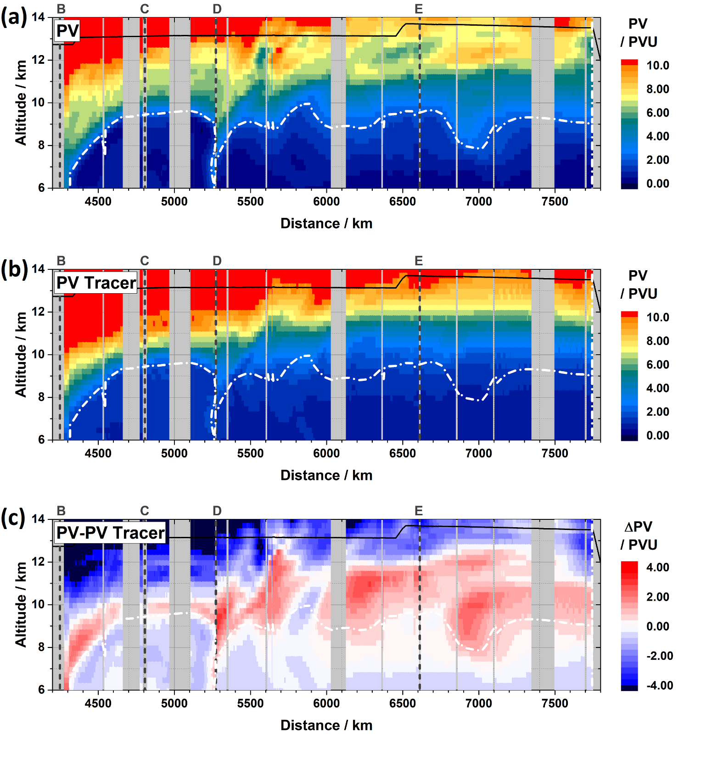
Figure 5. Vertical cross-sections of (a) potential vorticity PV, (b) PV tracer, and (c) PV - PV tracer.
Dash-dotted white lines indicate the PV = 2 PVU level as indicator for the dynamical tropopause.
HALO flight altitude indicated by black line in all panels.
The two white circles shows features of interest along the flight track. A fast and sharp decrease in altitude of the tropopause accompanied by an uplift in short distance.
1 PVU = 10⁻⁶ ∙ (K∙m²) / (kg∙s)

Slide 7
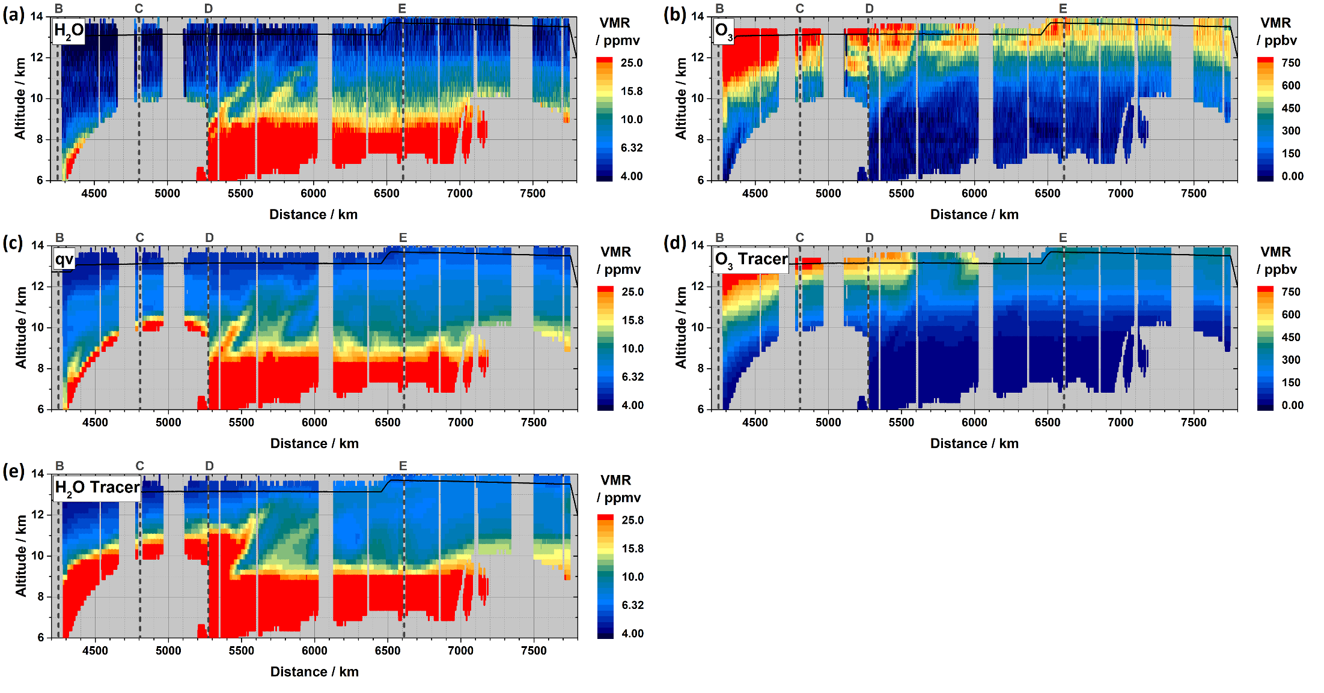
This uplift of air masses with tropospheric characteristics above the dynamical tropopause is seen in measurements as well as in the model simulations.
The question is where does this exchange is generated and what is the fate of it.
Figure 6. Fine-structures in GLORIA measurements and ICON-ART simulations. Vertical cross-sections along east-bound flight section. GLORIA (a) water vapour and (b) ozone, and ICON-ART (c) specific humidity, (d) ozone tracer, and (e) water vapour tracer at 18 UTC. HALO flight altitude indicated by black line in all panels.

Slide 8
Work plan
4D visualisation of tropopause represented by the simulated PV
Automatic identification of air masses of tropospheric origin above the tropopause (e.g. by analysing the qv and the PV fields)
=> Scientific question: Where is the origin of this exchange of tropospheric air through the tropopause into the stratosphere
Tracking of these air masses in time and space to visualise their atmospheric fate
=> Scientific question: Is the exchange reversible or not?

Slide 9
Acknowledgements
GLORIA measurements and plots: Wolfgang Woiwode (IMK-ASF)
ICON-ART simulations: Jennifer Schröter (IMK-ASF)
ICON-ART data in netCDF-Format can be assessed via an OPeNDAP-THREDDS solution set up by Uğur Çayoğlu (SCC-SDM) http://eos.scc.kit.edu/thredds/catalog/polstracc0new/catalog.html

Slide 10
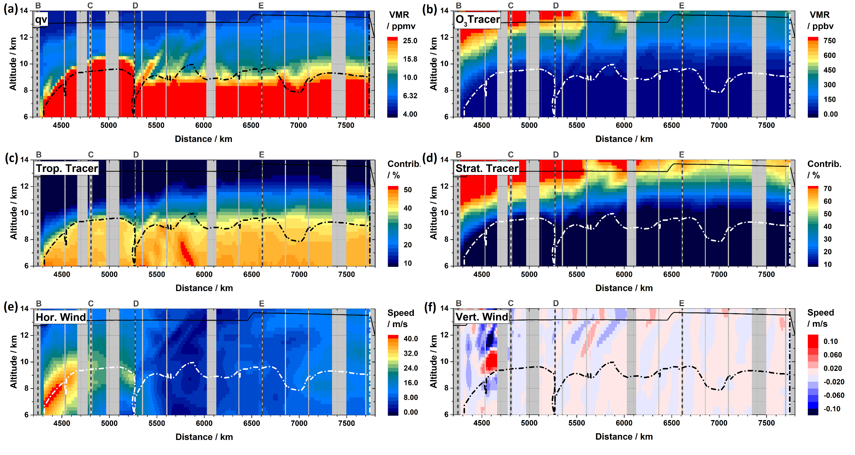
Figure 7. ICON-ART diagnostics along east-bound flight leg. Vertical cross-sections of (a) water vapour, (b) ozone, (c) artificial tropospheric tracer, (d) artificial stratospheric tracer, (e) horizontal wind speed, and (f) vertical wind speed. Dash-dotted lines indicate the 2 PVU level as indicator for the dynamical tropopause. HALO flight altitude indicated by black line in all panels. 1 PVU = 10⁻⁶ ∙ (K∙m²) / (kg∙s).

Slide 11
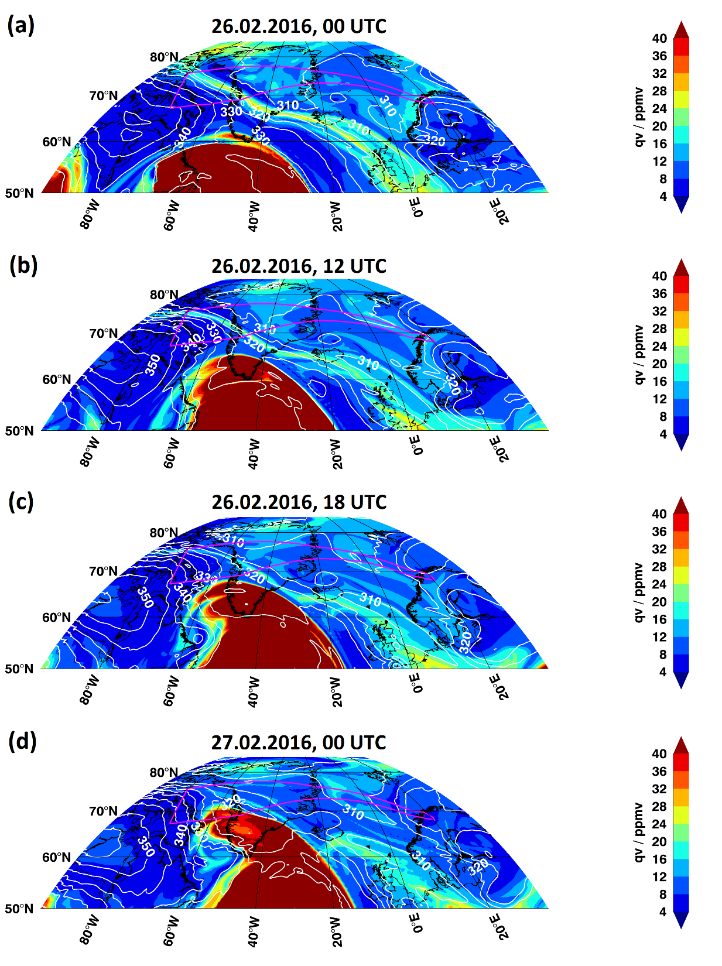
Figure 8. Advection and dissipation of filament. ICON-ART specific humidity (colour-coded contour) and potential temperature (white contour lines) at 10 km altitude at indicated time steps.

Slide 12
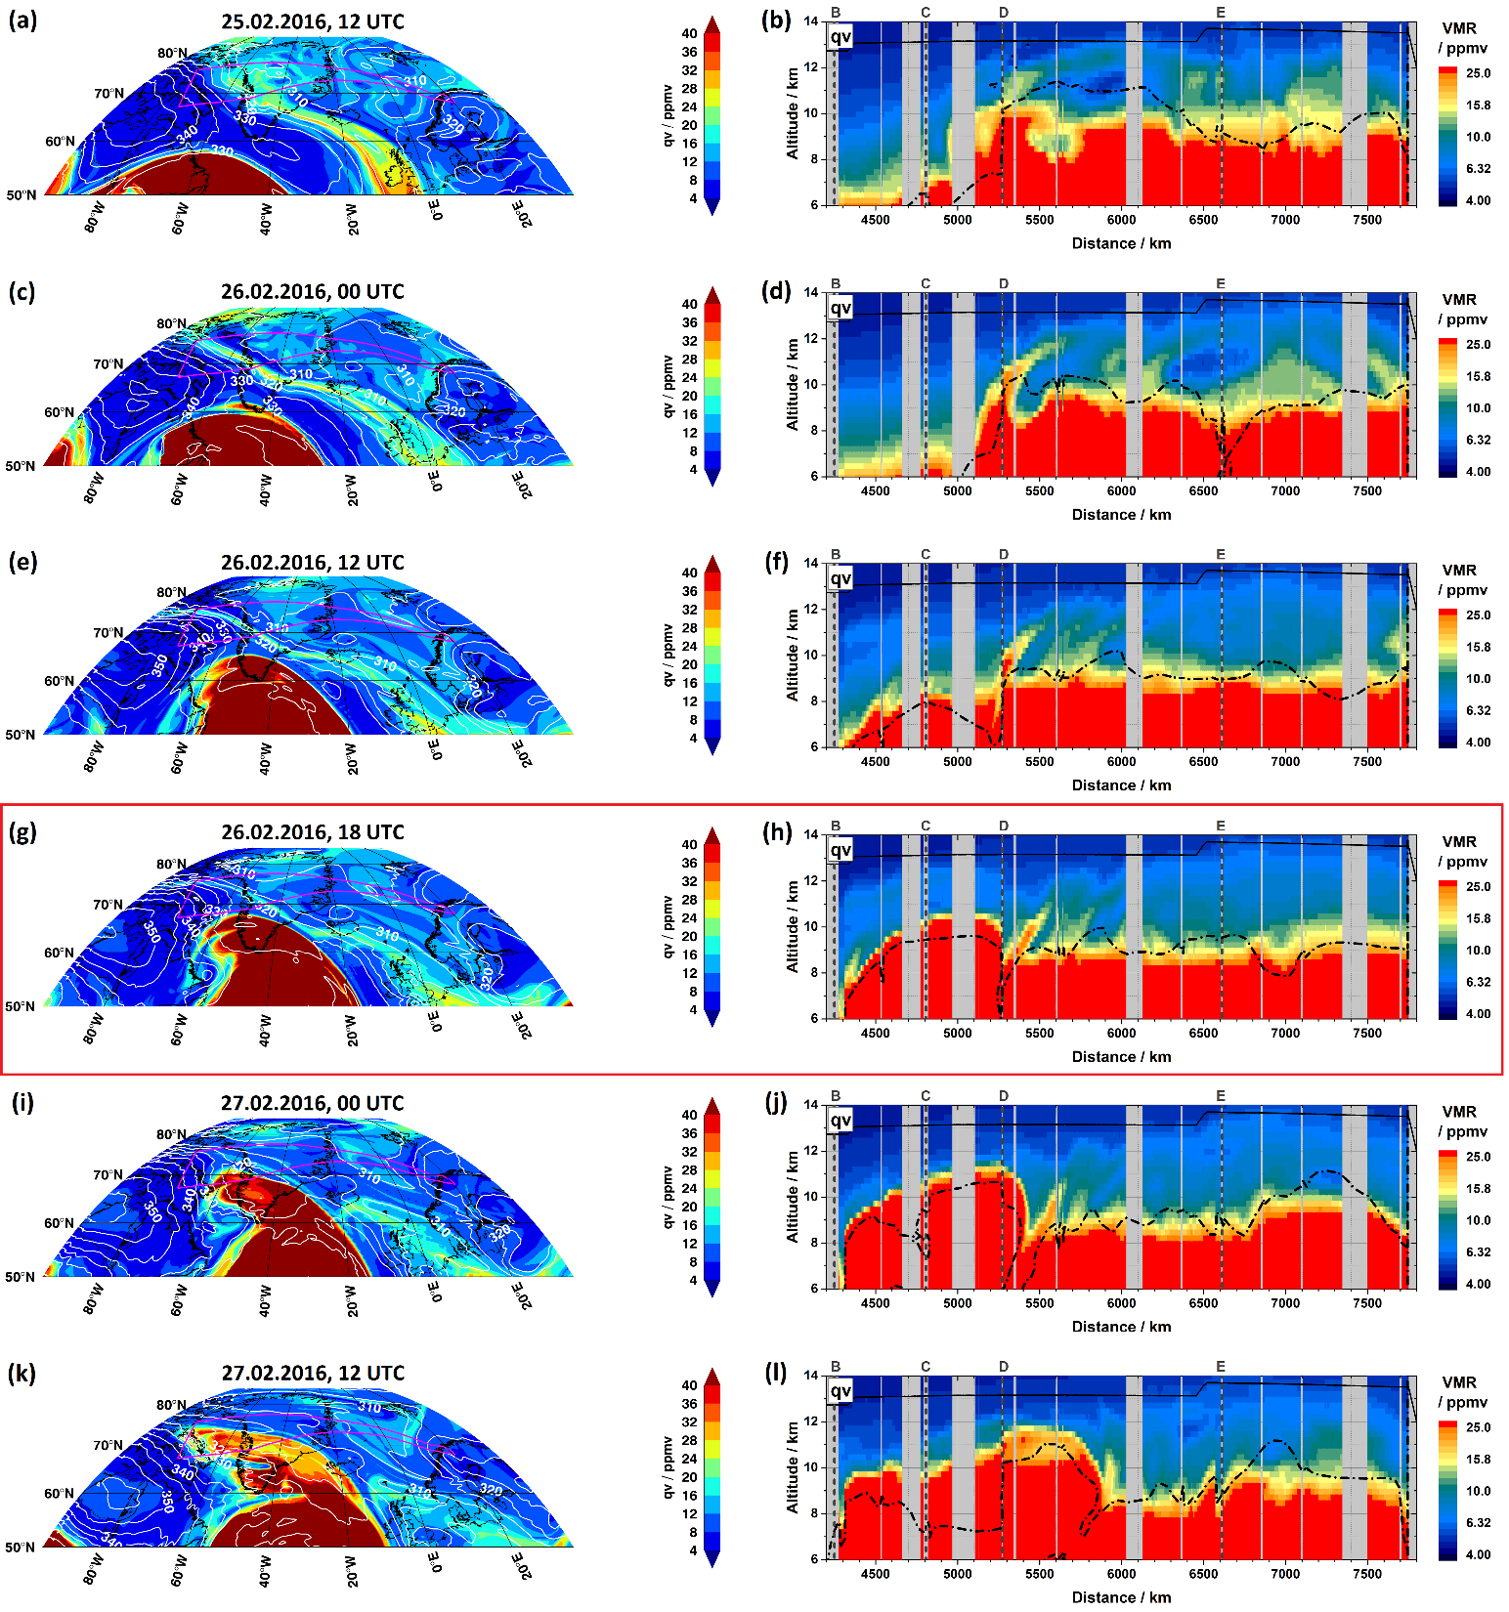
Figure 9. Generation and dissipation of filaments. Left column: ICON-ART specific humidity (colour-coded contour) and potential temperature (white contour lines) at 10 km altitude at indicated time steps. Right column: Respective vertical cross-sections of specific humidity along GLORIA observation geolocations of 26 February 2016. Magenta/black (left/right panels) lines: corresponding HALO flight track.

Slide 13
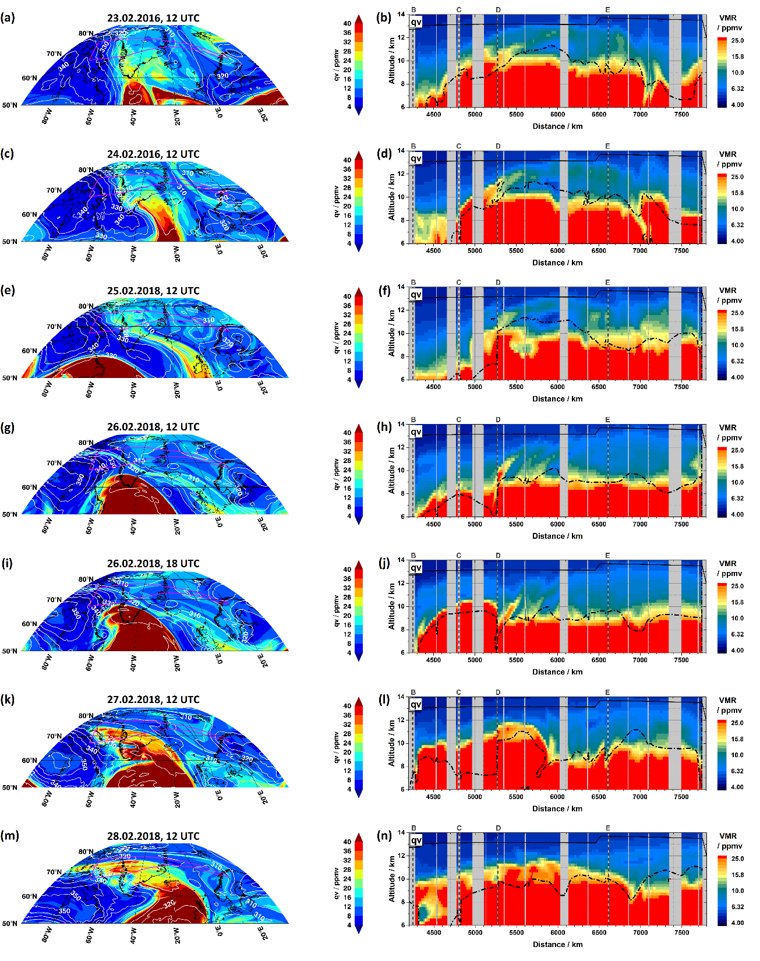
Figure 10. Generation and dissipation of filaments. Left column: ICON-ART specific humidity (colour-coded contour) and potential temperature (white contour lines) at 10 km altitude at indicated time steps. Right column: Respective vertical cross-sections of specific humidity along GLORIA observation geolocations of 26 February 2016. Magenta/black (left/right panels) lines: corresponding HALO flight track.

